Slide 1


ME4126D : OPTIMIZATION METHODS IN ENGINEERING
Department of Mechanical Engineering
NATIONAL INSTITUTE OF TECHNOLOGY, CALICUT
OPTIMIZED ALLOCATION OF PROJECT HUMAN RESOURCE
SUBMITTED BY
Bhukya Vasanth Kumar Jarpula Santosh Lingareddy Bharadwaj Vignesh Varikolu Karthikeya Tondepu
- B180441CS
- B180041ME
- B180142PE
- B181089PE
- B180937PE

Slide 2
1. ABSTRACT
The distribution of project human resources is critical right now. One of the most crucial yet often underestimated parts of project management is the human factor. The quality of talent engaged, and, more crucially, the manner in which management deploys talent on the project, is closely related to the project's success. Therefore, employee productivity is hampered by some deployed solutions that ignore employee preferences for which tasks they focus on. Those that do take employee preferences into account are non-deterministic, making it more difficult to assess the business process effectively.

Slide 3
Contd..
By combining competency model theory and staff expectations, we are trying to take these two concepts of, staff competency matching with work package requests and staff expectations matching with work packages in this study. Using some optimization methods, we should arrive at an optimal answer.

Slide 4
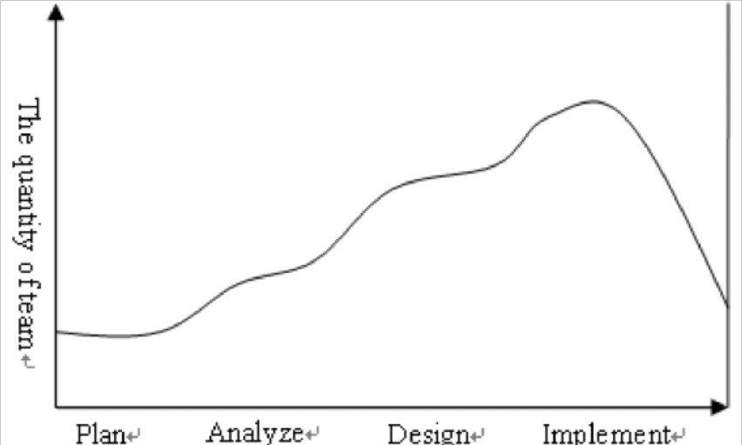
2. ALLOCATION OF HUMAN RESOURCES
The definition of project human resource allocation is that the project management assigns people to tasks in order to execute the project's tasks. The allocation of project human resources differs significantly from the allocation of normal human resources due to the characteristics of projects. In different stages of a project, the quantity and abilities of workers are required in different ways.

Slide 5
Contd..
First, the project team only requires a few people during the planning stage, primarily the project manager and one or two experienced staff members. At this point, experienced personnel with the relevant management skills are required. Second, during the analysis stage, members of the project team were requested to have strong analytical and problem-solving abilities. The project team is growing at this point with the addition of professional and technical personnel. Third, with the addition of engineers and quality control professionals during the project's implementation stage, the total number of employees has increased to the highest level.

Slide 6
3. ALLOCATION OPTIMISATION OF HUMAN RESOURCES BASED ON PSO
A. The Particle Swarm Optimization Algorithm
Particle Swarm Optimization (PSO) is a swarm theory-based optimization algorithm. It is well-suited for parallel computation and performs flawlessly on large-scale optimization problems since it mimics the behavior of biomes. PSO's main goal is to simulate flocks of birds flying around a mountain peak in a scene. Particles replace the birds in PSO, and the landscape's top is the peak of a fitness function. The particles move across the search space at a high velocity, creating flocks around fitness function peaks that are constantly updated by the particle's own experience as well as the experience of its neighbors or the entire swarm.
The status of a particle on the search space is determined by two factors: its position and velocity.

Slide 7
The position and velocity of the ith particle in the d-dimensional search space can be represented as
Xi = (xi1, xi2, xi3 ⋯ xiD) or Vi = (vi1, vi2, vi3 ⋯ viD). Each particle has its own best position
Pi = (pi1, pi2, pi3 ⋯ piD) corresponding to the personal best target value at the time k reached so far.
Globally optimal particles are represented by Pg = (pg1, pg2, pg3 ⋯ pgD). , The best particle ever found. The new velocity for each particle is calculated as follows:
vk + 1id = wvkid + c1r ∗ 1 (pid−xkid) + c2r ∗ 2 (pgd−xkid) (1)
If c1 and c2 are constants called acceleration coefficients, w is called the inertial weighting factor and r1 and r2 are two independent random numbers evenly distributed in the range [0,1].
Therefore, the position of each particle is updated for each generation according to the following formula.
xk + 1id = xkid + vk + 1id 1≤i≤n; 1≤d≤D （2）

Slide 8
In general, the value of each component in vid is clamped in the range [-Vmaxd, Vmaxd] by (1) to control excessive roaming of particles outside the search space. The particle then flies to a new position according to (2). This process repeats until the user-defined exit criteria are met.
B. The mathematics model of project human resource
The WBS (Work Breakdown Structure) is a deliverable-oriented hierarchical decomposition of the work to be performed by the project team in order to meet the project's objectives and produce the requisite deliverables. The project's complete scope is organized and defined by the WBS. The WBS separates the project work into smaller, more manageable chunks, with each WBS level providing a more precise definition of the project task. Work packages, which are the lowest-level WBS components, can be scheduled, cost, tracked, and controlled.
This document describes the issue of combining project WBSs and optimizing project staff assignments as follows: Allocate M staff to n work packages. Each work package can only accept specific staff and must meet the requirement that all assigned staff meet the capacity requirements of each work package. The mathematical model was developed as follows.

Slide 9
maxz（y）= ∑i = 1nf（yi）
S.t.G0（y）= ∑i = 1ngi
（yi）≤Myi= 0,1、…、M∀i。
(4)
(5)
(6)
According to the mathematical model above, it can be extended to a new mathematical model of optimization
maxz (x) = ∑i = 1n∑j = 0Mpijxij
pij = Ei × ∑inαil (dijl−d0il) d0il × DijDjmax
S.t. G0 (x) = ∑i = 1n ∑j = 0Mjxij ≤ M,
Gi (x) = ∑j = 1nxij = 1, ∀i,
∑inαil (dijl−d0il) d0il ≥ 0,
xij = 0or1, ∀i, j
(6)
(7)
(8)
(9)
(10)
(11)

Slide 10
In this model, due to the issue of staffing in Project M, workers are assigned to n different work packages in order to maximize utility and be constrained. It is formulated as an integer programming model as follows:
Where Vi is the importance of the i-th working package (j = 1,2,… n)); αil is the weight of the l-th capability of the i-th working package. (J = 1,2, ... n; l = 1, 2, ...); dijl is the level of the lth ability of the jth working package. (1 = 1,2, ... M; ≤ dijl ≤ 9, dijl ∈ N); d0il is the reference level for the lth capability of the working package. (L = 1, 2,… M; 1 ≤ dijl ≤ 9, dijl ∈ N); Dij is the jth employee's expected level for the ith work package. (1 ≤ Dij ≤ 9, Dij ∈ N); Djmax is the highest level of jth staff in all working packages.
Parameters
I
j
N
M
index, (i = 1,2,…, N);
bar index, (J = 1,2,…, M);
Total number of working packages. Total number of employees.

Slide 11
4. PARTICLES CODING
This section describes the formulation of PSO algorithms for personnel in allocation optimization projects. An important realization of the algorithm is that we need to find a way to generate particles that correspond to the solution to the problem. This paper proposes a coding method in which a particle consists of "n" parts, each part using a binary system for coding. `n` is n working packages. The length of each part is the number of rods assigned. The number 0 in the binary system code indicates that no staff has been assigned to the work package. Number 1 in the binary system code indicates that staff is assigned to the work package. The specific code is:
[A1, A2, ⋯ AI | B1, B2, ⋯ BJ | ⋯ | | C1, C2, ⋯ | |where the number is 0 or 1, 1 represents the staff to be selected, otherwise the contrary.
Before the program is executed, it is necessary to test each particle's legitimacy. It will reduce the calculation by wiping legal particles.

Slide 12
The test limit is as follows.
Number of employees in all work packages:
4σi = 1 mai = Si = Si limits the condition that the number of work packets of employee SI is.
4σI = 1 MBJ = SJ restricts the state where the number of second work packets of the second work packet is SJ.
4σMI = 1CK = SK limits the condition that there are a number of third work packages of the staff SK. Second, if the personnel are selected by the work package, it is not found in another work package. Therefore, the program needs to be tested if the same staff is found in different work packages.
Finally, the sum of all particle codes that are 1 is the total number of candidate employees.
Example: The project manager expects to assign 10 candidates to 3 working packages. One of the particle codes is P: [0101001010 | 1010100000 | 0000010100]. The meaning of this particle is that manager 2,4,7,9 assigns employee 2,4,7,9 to work package 1. Employee numbers 1, 3, and 5 are assigned to work package 2. Numbers 6 and 8 are assigned to work package 3.

Slide 13
This white paper outlines the PSO process for a talent allocation optimization project. This is explained as follows:
Initialization PSO. Includes population size N, particle position xi, velocity vi. According to the limited conditions, the correctness of each particle should be tested first.
Calculate the fitness value of the objective function according to equation (6). Use weights to get the initial pBest and gBest. Updates the particles according to the standard PSO algorithm. Updated the velocity vi and position xi of each particle with gBest and pBest of Stepl. If the pause condition is met, the circuit will stop. Otherwise, go back to step 2.
5 . APPLICATION OF MODEL
In this research, we examined a human resources allocation project based on a software development project. The project team develops e-business systems for enterprises.
E-business systems have three subsystems. One is the Product Information Management Subsystem (PIMS) and the other is the Custom Information Management Subsystem (CIMS). The other one is an order information management subsystem

Slide 14
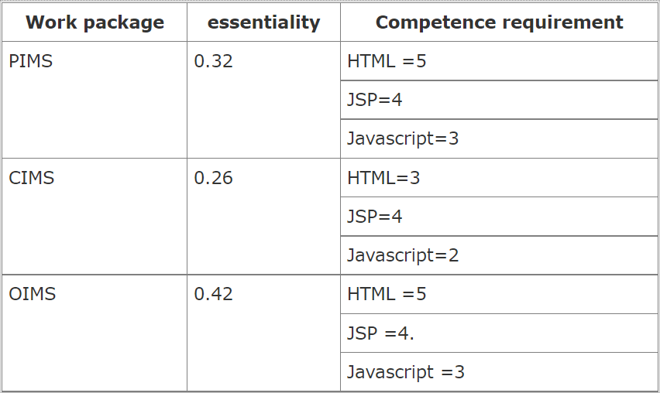
(OIMS). Therefore, the e-business system was divided into three modules. Table 1 shows the importance and capacity requirements of all work packages. Table 2 shows the competency levels and expectations of all employees (omitted). The project manager assigns 10 employees to 3 work packages. The first work package requires three employees. The second work package requires three employees. The third work package requires four employees.

Slide 15
We ran a simulation using MATLAB 7.0 to prove the efficiency of the model. Based on numerous experiments, the optimal parameters for particles are: The number of particles is equal to 80. The flock is divided into ring topologies. The neighbor subgroup size is 4. wint = 0.94, weeknd = 0.13 c1 = c2 = 1.28, s max = 800. You can get satisfactory results with algorithms that have been validated in many experiments. After simulating PSO, you can get the best solution for this problem. The best particle solutions are: P: [1001000001 | 0100010010 | 0010101100]. Therefore, the project manager assigns NO to the employee. Place 1, 4, 10 first working package and bar.
Assign 2, 6, 9 to the second work package and staff numbers 3, 5, 7, 8 to the third work package.

Slide 16
6 . CONCLUSION
In this paper, when developing a mathematical model of project staff allocation, we applied competency models and employee expectations to integrate the interests of some employees into the work package. This method embodies the dual principle of matching employee capabilities with work package requirements and employee expectations with work packages that correspond to the actual situation of human resource management. In addition, applying PSOs to solve problems in optimizing
talent allocation in projects has fully demonstrated the benefits of PSOs with high quality solutions and fast convergence.

